Slide 1
Session 2
Hidden Markov Models applied to Clustering of Biological Sequences

Slide 2
Markov model
t0
t1
t2
t3
t4
t5
t6
Markov chain
A
A
C
A
G
G
T
A
C
Four possible categories
P(t+1=C|t=A)
Probability transition matrix
G
T

Slide 3
How to identify a pattern of characters?
t0
t1
t2
t3
t4
t5
t6
Markov chain
A
A
C
A
G
G
T
v
$$P\left(AACAGGT\right)=P(A)P\left(A\left|A\right)P\left(C | A\right)P\left(A | C\right)P\left(G | A\right)P\left(G | G\right)P(T|G\right)$$
Prior probability
A
C
G
T

Slide 4
How does the rates of evolution change over a sequence?

Slide 5
How does the rates of evolution change over a sequence?
Fast evolving
Slow evolving
Intermediate evolving

Slide 6
How does the rates of evolution change over a sequence?
The Probability that I will be in one state or another depends on the surrounding nucleotides

Slide 7
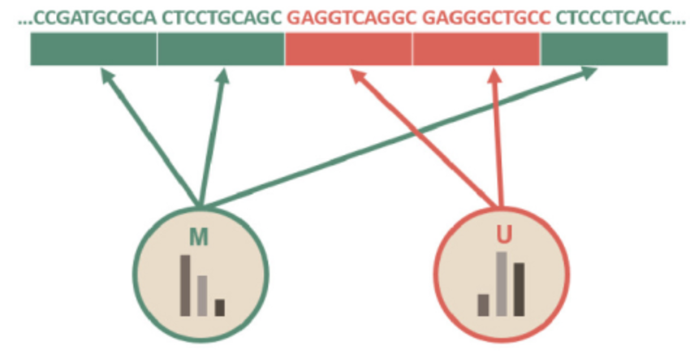
Other examples of finding a pattern in the sequence: Metilation
DNA Metilation
A Review of Three Different Studies on Hidden Markov Models for Epigenetic Problems: A Computational Perspective

Slide 8
How does a phenotype change over a phylogeny?
Identifying Hidden Rate Changes in the Evolution of a Binary Morphological Character:
The Evolution of Plant Habit in Campanulid Angiosperms
JEREMY M. BEAULIEU1,∗, BRIAN C. O’MEARA2, AND MICHAEL J. DONOGHUE1

Slide 9
How to identify a pattern of characters?
2) To which rate of evolution each nucleotide belongs to?
Hidden because the state (Fast, Intermediate, Slow) is unknown
ATGATTTCAAAAGGACCATCATTAGGA
Observed categories
FFF I I I I I I S S S…
Hidden states
Fast (F), Intermediate (I) or Slow (S) is hidden (in fact, this is what we want to estimate!)

Slide 10
What am I saying when I use a HMM?
“My data is a mixture of k probability distributions, each determined by its own parameters”
“The probability of using one probability distribution or another depends on which one I used in the previous step”

Slide 11
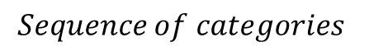
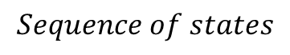
$$Sequence of categories$$
x0
x1
x2
x3
x4
xi
x6
= x
A
A
C
A
G
G
T
$$Sequence of states$$
π1
π2
π3
π4
π5
πi
π7
= π
SOME NOTATION

Slide 12
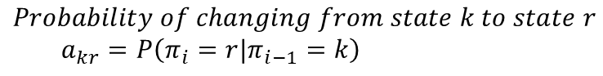
$$Sequence of categories$$
x0
x1
x2
x3
x4
x5
x6
A
A
C
A
G
G
T
$$Sequence of states$$
π1
π2
π3
π4
π5
π6
π7
$$Probability of emission of category b at position i given that I am using state k=e_{k}\left(b\right)=P\left(x_{i}=b|π_{i}=k\right)$$
State π=r
Intermediate
Category
Category | Probability
A
C
T
G
$$Probability of changing from state k to state r$$
$$a_{kr}=P\left(π_{i}=r|π_{i−1}=k\right)$$
Emission probabilities of state π
Fast evolving
Slow evolving
Category | Probability
A
C
T
G
Category | Probability
A
C
T
G
State π=k

Slide 13
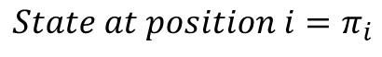
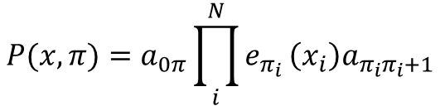
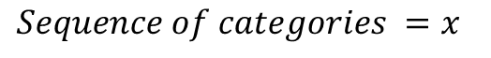
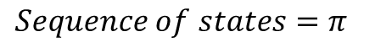
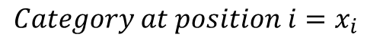
NOTATION HMM
$$State at position i=π_{i}$$
$$Sequence of states=π_{}$$
$$Category at position i=x_{i}$$
$$Sequence of categories =x_{}$$
$$P(x,π)=a_{0π}{\prod_{i}^{N}{e_{π_{i}}}\left(x_{i}\right)a}_{π_{i}π_{i}+1}$$
Initial state (“Probability that I started the chain at state π”)

Slide 14
$$Probability of changing from state k to state r=a_{kr}=P\left(π_{i}=r|π_{i−1}=k\right)$$
Given that I was in the previous position using state k
I am using state r
 | Fast Evolving | Intermediate Evolving | Slow Evolving
Fast Evolving
Intermediate Evolving
Slow Evolving
Transmission matrix
Fast evolving
Intermediate
Slow evolving
Category | Probability
A
C
T
G
Category | Probability
A
C
T
G
Category | Probability
A
C
T
G
Emission Probability matrix for each possible state
$$Probability of emission of category b at position i given that I am using state k=e_{k}\left(b\right)=P\left(x_{i}=b|π_{i}=k\right)$$

Slide 15
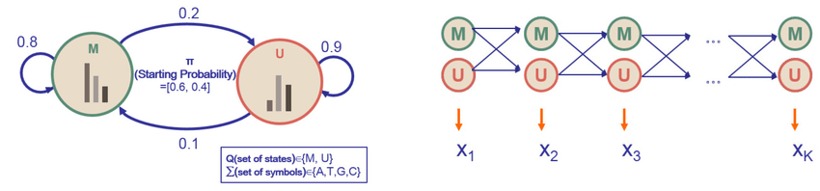
HMM: Multiple ways of modelling
DNA Metilation
A Review of Three Different Studies on Hidden Markov Models for Epigenetic Problems: A Computational Perspective

Slide 16
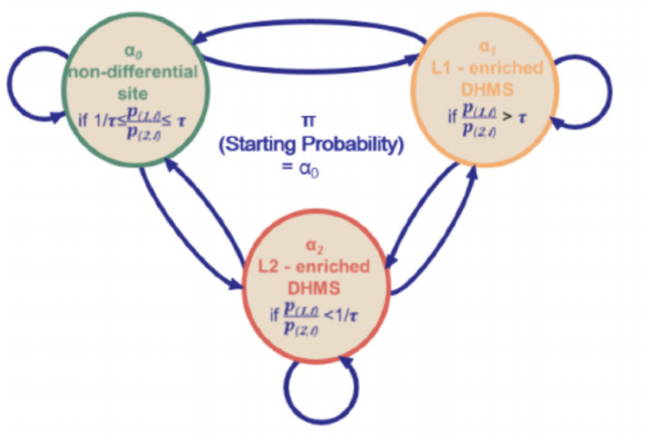
HMM: Multiple ways of modelling
DNA Metilation
differential histone modification sites (DHMSs)
A Review of Three Different Studies on Hidden Markov Models for Epigenetic Problems: A Computational Perspective

Slide 17
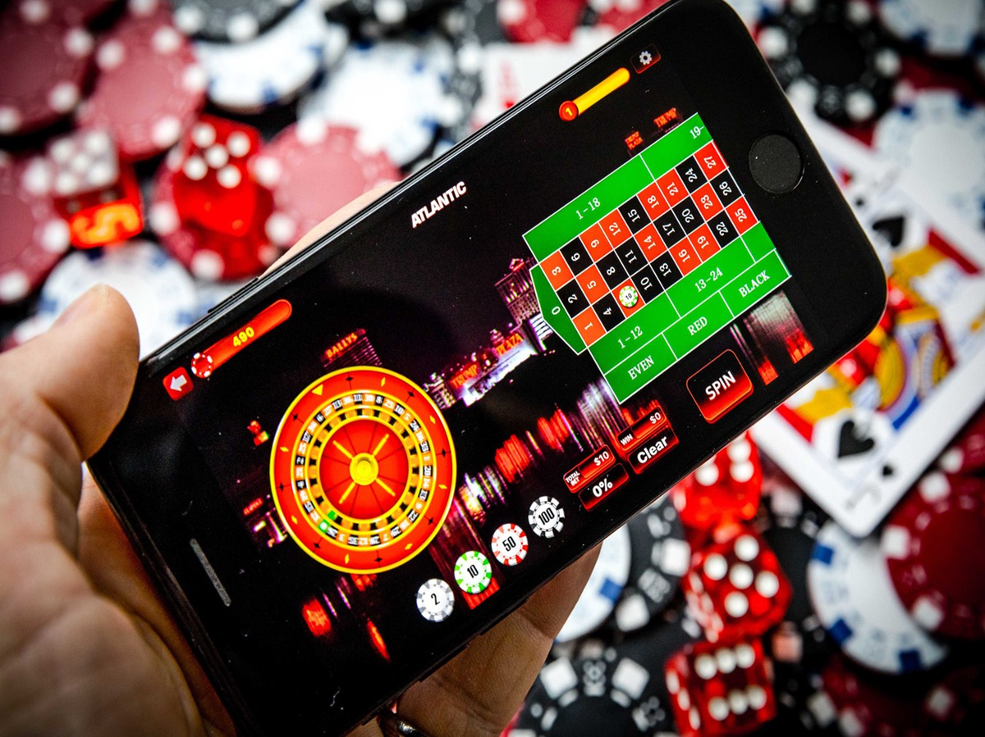
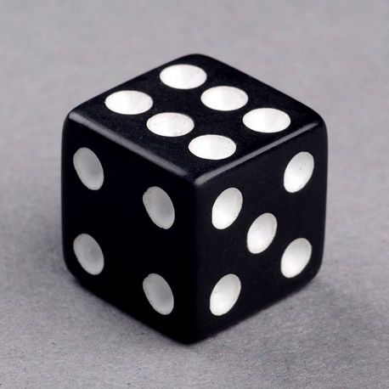
HMM: A simple working case
The occasionally dishonest casino problem
With some probability, the casino uses a dice that is LOADED so the number six (the bench wins) occurs more often (P(6)=0.5 than expected at random.
HOW CAN WE KNOW WHEN IT IS LOADED OF FAIR?

Slide 18
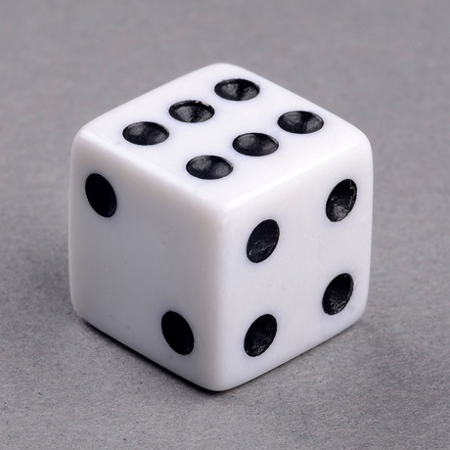
HMM
The occasionally dishonest casino problem.
0.95
State Loaded
0.9
State Fair
Probability of making a change from one state to another
0.1
0.05
Emission probabilities of fair dice
Emission probabilities of loaded dice
1 | 2 | 3 | 4 | 5 | 6
1/6 | 1/6 | 1/6 | 1/6 | 1/6 | 1/6
1 | 2 | 3 | 4 | 5 | 6
1/10 | 1/10 | 1/10 | 1/10 | 1/10 | 1/2
Fair (F) dice
Loaded (L) dice

Slide 19
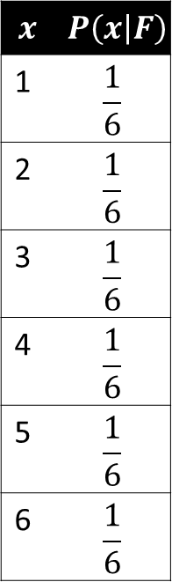
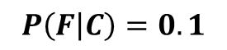
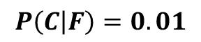
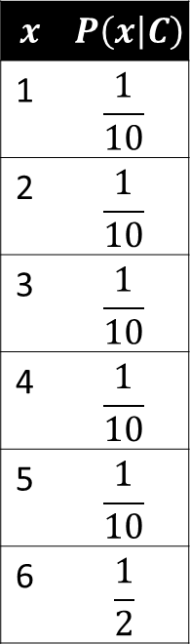
HMM:
1,3,4,5,1,2,6,6,3,6,6,2,1,2,4,5
$$x$$ | $$P\left(x | F\right)$$
1 | $$\frac{1}{6}$$
2 | $$\frac{1}{6}$$
3 | $$\frac{1}{6}$$
4 | $$\frac{1}{6}$$
5 | $$\frac{1}{6}$$
6 | $$\frac{1}{6}$$
$$x$$ | $$P\left(x | C\right)$$
1 | $$\frac{1}{10}$$
2 | $$\frac{1}{10}$$
3 | $$\frac{1}{10}$$
4 | $$\frac{1}{10}$$
5 | $$\frac{1}{10}$$
6 | $$\frac{1}{2}$$
$$P\left(C | F\right)=0.01$$
$$P\left(F | C\right)=0.1$$

Slide 20
HMM: Probability of x given model?
P(1,3,4,5,1,2,6,6,3,6,6,2,1,2,4,5|HMM)
$$x$$ | $$P\left(x | F\right)$$
1 | $$\frac{1}{6}$$
2 | $$\frac{1}{6}$$
3 | $$\frac{1}{6}$$
4 | $$\frac{1}{6}$$
5 | $$\frac{1}{6}$$
6 | $$\frac{1}{6}$$
$$x$$ | $$P\left(x | C\right)$$
1 | $$\frac{1}{10}$$
2 | $$\frac{1}{10}$$
3 | $$\frac{1}{10}$$
4 | $$\frac{1}{10}$$
5 | $$\frac{1}{10}$$
6 | $$\frac{1}{2}$$
It refers to the values of emission and transmission that are used for the k considered states
$$P\left(C | F\right)=0.01$$
$$P\left(F | C\right)=0.1$$

Slide 21
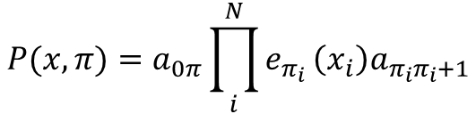
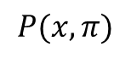
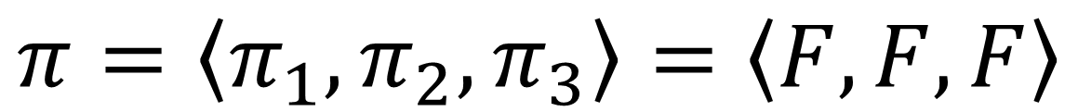
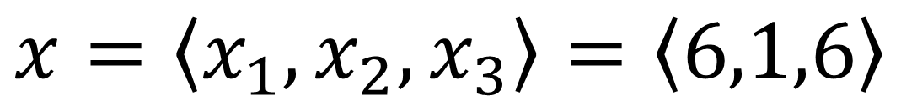
HMM
Probability of a sequence x given that the states of the sequence are known and we have the HMM model
Imagine we observe the sequence x
$$x=\left\langle x_{1},x_{2},x_{3}\right\rangle =\left\langle 6,1,6\right\rangle$$
Assume that the prior probability of starting at one state or at the other is the same (0.5)
What would be the probability
$$P(x,π)$$
if the state sequence was
$$π=\left\langle π_{1},π_{2},π_{3}\right\rangle =\left\langle F,F,F\right\rangle$$
$$P(x,π)=a_{0π}{\prod_{i}^{N}{e_{π_{i}}}\left(x_{i}\right)a}_{π_{i}π_{i}+1}$$
$$P\left(x,π\right)=0.5∗0.95∗\frac{1}{6}∗0.95∗\frac{1}{6}∗0.95∗\frac{1}{6}=0.001984664$$
Prior of starting at F
Prob of staying at state F
Emission prob of 6 at state F

Slide 22
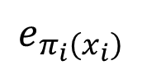
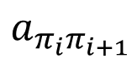
HMM: Probability of x given model?
P(1,3,4,5,1,2,6,6,3,6,6,2,1,2,4,5|HMM)
We know that in a MC it is just:
P(S|Markov Chain) = P(1)P(3|1)P(4|3)…
P(S|Hidden Markov Chain): P(1)P(3|1)P(4|3)…
In our previous HMM notation
In a HMC this chain explodes!
P(3|F)P(F|C)
P(3|C)P(C|C)
$$e_{π_{i}\left(x_{i}\right)}$$
P(C)
P(1|C)
$$a_{π_{i}π_{i+1}}$$
P(3|F)P(F|F)
P(F)
P(1|F)
P(3|C)P(C|F)

Slide 23

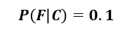
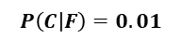
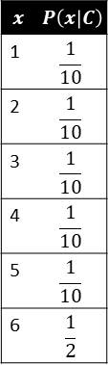
HMM: Probability of x given model? Forward
P(1,3,4,5,1,2,6,6,3,6,6,2,1,2,4,5|HMM)
$$x$$ | $$P\left(x | F\right)$$
1 | $$\frac{1}{6}$$
2 | $$\frac{1}{6}$$
3 | $$\frac{1}{6}$$
4 | $$\frac{1}{6}$$
5 | $$\frac{1}{6}$$
6 | $$\frac{1}{6}$$
$$x$$ | $$P\left(x | C\right)$$
1 | $$\frac{1}{10}$$
2 | $$\frac{1}{10}$$
3 | $$\frac{1}{10}$$
4 | $$\frac{1}{10}$$
5 | $$\frac{1}{10}$$
6 | $$\frac{1}{2}$$
 | 1 | 3 | 4 | …
F | 0.5*1/6
L | 0.5*1/10
$$P\left(C | F\right)=0.01$$
$$P\left(F | C\right)=0.1$$

Slide 24
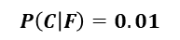
HMM: Probability of x given model? Forward
P(1,3,4,5,1,2,6,6,3,6,6,2,1,2,4,5|HMM)
F,F
$$x$$ | $$P\left(x | F\right)$$
1 | $$\frac{1}{6}$$
2 | $$\frac{1}{6}$$
3 | $$\frac{1}{6}$$
4 | $$\frac{1}{6}$$
5 | $$\frac{1}{6}$$
6 | $$\frac{1}{6}$$
$$x$$ | $$P\left(x | C\right)$$
1 | $$\frac{1}{10}$$
2 | $$\frac{1}{10}$$
3 | $$\frac{1}{10}$$
4 | $$\frac{1}{10}$$
5 | $$\frac{1}{10}$$
6 | $$\frac{1}{2}$$
 | 1 | 3 | 4 | …
F | 0.5*1/6 | 0.5*1/6*0.99*1/6
L | 0.5*1/10
$$P\left(C | F\right)=0.01$$
$$P\left(F | C\right)=0.1$$

Slide 25
HMM: Probability of x given model? Forward
P(1,3,4,5,1,2,6,6,3,6,6,2,1,2,4,5|HMM)
F,F
$$x$$ | $$P\left(x | F\right)$$
1 | $$\frac{1}{6}$$
2 | $$\frac{1}{6}$$
3 | $$\frac{1}{6}$$
4 | $$\frac{1}{6}$$
5 | $$\frac{1}{6}$$
6 | $$\frac{1}{6}$$
$$x$$ | $$P\left(x | C\right)$$
1 | $$\frac{1}{10}$$
2 | $$\frac{1}{10}$$
3 | $$\frac{1}{10}$$
4 | $$\frac{1}{10}$$
5 | $$\frac{1}{10}$$
6 | $$\frac{1}{2}$$
C,F
 | 1 | 3 | 4 | …
F | 0.5*1/6 | 0.5*1/6*0.99*1/6+ 0.5*1/10*0.1*1/6
L | 0.5*1/10
$$P\left(C | F\right)=0.01$$
$$P\left(F | C\right)=0.1$$

Slide 26
HMM: Probability of x given model? Forward
P(1,3,4,5,1,2,6,6,3,6,6,2,1,2,4,5|HMM)
F,F
$$x$$ | $$P\left(x | F\right)$$
1 | $$\frac{1}{6}$$
2 | $$\frac{1}{6}$$
3 | $$\frac{1}{6}$$
4 | $$\frac{1}{6}$$
5 | $$\frac{1}{6}$$
6 | $$\frac{1}{6}$$
$$x$$ | $$P\left(x | C\right)$$
1 | $$\frac{1}{10}$$
2 | $$\frac{1}{10}$$
3 | $$\frac{1}{10}$$
4 | $$\frac{1}{10}$$
5 | $$\frac{1}{10}$$
6 | $$\frac{1}{2}$$
C,F
 | 1 | 3 | 4 | …
F | 0.5*1/6 | 0.5*1/6*0.99*1/6+ 0.5*1/10*0.1*1/6
L | 0.5*1/10 | 0.5*1/10*0.9*1/10
$$P\left(C | F\right)=0.01$$
$$P\left(F | C\right)=0.1$$
C,C

Slide 27
HMM: Probability of x given model? Forward
P(1,3,4,5,1,2,6,6,3,6,6,2,1,2,4,5|HMM)
F,F
$$x$$ | $$P\left(x | F\right)$$
1 | $$\frac{1}{6}$$
2 | $$\frac{1}{6}$$
3 | $$\frac{1}{6}$$
4 | $$\frac{1}{6}$$
5 | $$\frac{1}{6}$$
6 | $$\frac{1}{6}$$
$$x$$ | $$P\left(x | C\right)$$
1 | $$\frac{1}{10}$$
2 | $$\frac{1}{10}$$
3 | $$\frac{1}{10}$$
4 | $$\frac{1}{10}$$
5 | $$\frac{1}{10}$$
6 | $$\frac{1}{2}$$
C,F
 | 1 | 3 | 4 | …
F | 0.5*1/6 | 0.5*1/6*0.99*1/6+ 0.5*1/10*0.1*1/6
L | 0.5*1/10 | 0.5*1/10*0.9*1/10 + 0.5*1/6*0.01*1/6
$$P\left(C | F\right)=0.01$$
$$P\left(F | C\right)=0.1$$
C,C
F,C
We have searched all the combinations

Slide 28
HMM: Probability of x given model? Forward
P(1,3,4,5,1,2,6,6,3,6,6,2,1,2,4,5|HMM)
 | 1 | 3 | 4 | …
F | 0.5*1/6 | 0.5*1/6*0.99*1/6+ 0.5*1/10*0.1*1/6
L | 0.5*1/10 | 0.5*1/10*0.9*1/10 + 0.5*1/6*0.01*1/6
P1
P1+P2 =P(S|HMM)
P2

Slide 29
Some computational considerations….
Each step implies multiplying a small number by a number between 0 and 1 (the probability of doing that step).
We end having VERY small numbers, which ultimately will produce underflow
Do a log transformation (you can do this whenever you multiply probabilities)
Scale the probability at each step (you do this when you multiply and add probabilities)

Slide 30
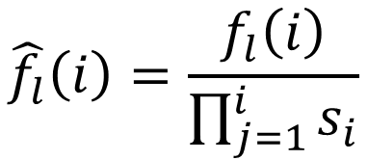
HMM
Scale the probability at each step (Rabiner 1989)
State | P(i) | P(i+1)
State1
State2
StateK
$$\hat{f_{l}}\left(i\right)=\frac{f_{l}\left(i\right)}{\prod_{j=1}^{i}{s_{i}}}$$
Scaling factor

Slide 31
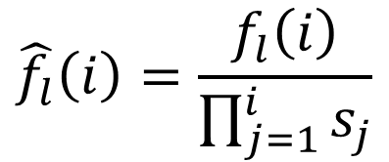
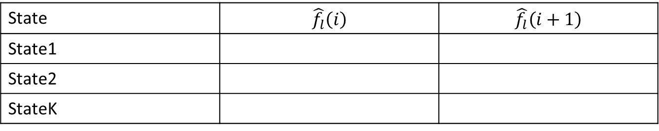
HMM
Scale the probability at each step (Rabiner 1989)
State | $$\hat{f_{l}}\left(i\right)$$ | $$\hat{f_{l}}\left(i+1\right)$$
State1
State2
StateK
$$\hat{f_{l}}\left(i\right)=\frac{f_{l}\left(i\right)}{\prod_{j=1}^{i}{s_{j}}}$$
New scaled variable

Slide 32
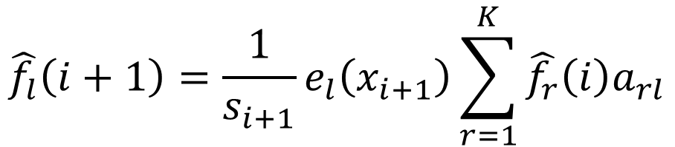
HMM
Scale the probability at each step (Rabiner 1989)
State | $$\hat{f_{l}}\left(i\right)$$ | $$\hat{f_{l}}\left(i+1\right)$$
State1
State2
StateK
Probability of moving from state r to state l in i+1
$$\hat{f_{l}}\left(i+1\right)=\frac{1}{s_{i+1}}e_{l}\left(x_{i+1}\right)\sum_{r=1}^{K}{\hat{f_{r}}\left(i\right)a_{rl}}$$
Scaled forward
Emission probability of category at xi+1 using state l

Slide 33
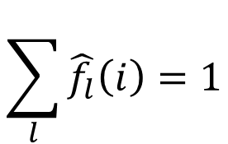
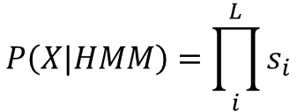
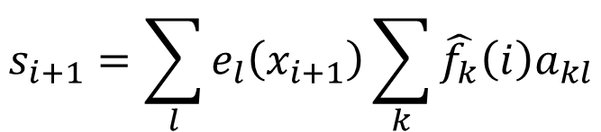
HMM
Scale the probability at each step (Rabiner 1989)
State | $$\hat{f_{l}}\left(i\right)$$ | $$\hat{f_{l}}\left(i+1\right)$$
State1
State2
StateK
If we impose that
Then si+1 is
Total of the scaled value
$$\sum_{l}{\hat{f_{l}}\left(i\right)=1}$$
$$s_{i+1}=\sum_{l}{e_{l}\left(x_{i+1}\right)\sum_{k}{\hat{f_{k}}\left(i\right)a_{kl}}}$$
$$P\left(X|HMM\right)=\prod_{i}^{L}{s_{i}}$$

Slide 34
HMM
What happens when the parameters are not known?
?
State Loaded
?
State Fair
Probability of making a change from one state to another
?
?
Emission probabilities of fair dice
Emission probabilities of loaded dice
1 | 2 | 3 | 4 | 5 | 6
? | ? | ? | ? | ? | ?
1 | 2 | 3 | 4 | 5 | 6
? | ? | ? | ? | ? | ?
Fair (F) dice
Loaded (L) dice

Slide 35
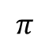
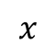
HMM
What happens when the parameters are not known?
1 We have a training dataset where we know the hidden state
$$x$$
1,4,5,1,3,2,1,6,6,4,1,6,6,6,6,6,2,3,4,5,1,4,3,6,2,1,3,5,6,6,6,6,6,6,6,1,2,3,1,1,1,1,2,3,4,5,5,4
$$π$$
F,F,F,F,F,F,F,L,L,L,L,L,L,L,L,L,F,F,F,F,F,F,F,F,F,F,F,F,L,L,L,L,L,L,L,F,F,F,F,F,F,F,F,F,F,F,F,F,L,L

Slide 36
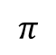
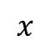
HMM
$$x$$
1,4,5,1,3,2,1,6,6,4,1,6,6,6,6,6,2,3,4,5,1,4,3,6,2,1,3,5,6,6,6,6,6,6,6,1,2,3,1,1,1,1,2,3,4,5,5,4
$$π$$
F,F,F,F,F,F,F,L,L,L,L,L,L,L,L,L,F,F,F,F,F,F,F,F,F,F,F,F,L,L,L,L,L,L,L,F,F,F,F,F,F,F,F,F,F,F,F,F,L,L
?
State Loaded
?
State Fair
Probability of making a change from one state to another
?
?
Emission probabilities of fair dice
Emission probabilities of loaded dice
1 | 2 | 3 | 4 | 5 | 6
? | ? | ? | ? | ? | ?
1 | 2 | 3 | 4 | 5 | 6
? | ? | ? | ? | ? | ?
Fair (F) dice
Loaded (L) dice

Slide 37
HMM
$$x$$
1,4,5,1,3,2,1,6,6,4,1,6,6,6,6,6,2,3,4,5,1,4,3,6,2,1,3,5,6,6,6,6,6,6,6,1,2,3,1,1,1,1,2,3,4,5,5,4
$$π$$
F,F,F,F,F,F,F,L,L,L,L,L,L,L,L,L,F,F,F,F,F,F,F,F,F,F,F,F,L,L,L,L,L,L,L,F,F,F,F,F,F,F,F,F,F,F,F,F,L,L
?
State Loaded
?
State Fair
Probability of making a change from one state to another
?
?
Emission probabilities of fair dice
Emission probabilities of charged dice
1 | 2 | 3 | 4 | 5 | 6
? | ? | ? | ? | ? | ?
1 | 2 | 3 | 4 | 5 | 6
? | ? | ? | ? | ? | ?
Fair (F) dice
Loaded (L) dice

Slide 38
HMM
$$x$$
1,4,5,1,3,2,1,6,6,4,1,6,6,6,6,6,2,3,4,5,1,4,3,6,2,1,3,5,6,6,6,6,6,6,6,1,2,3,1,1,1,1,2,3,4,5,5,4
$$π$$
F,F,F,F,F,F,F,L,L,L,L,L,L,L,L,L,F,F,F,F,F,F,F,F,F,F,F,F,L,L,L,L,L,L,L,F,F,F,F,F,F,F,F,F,F,F,F,F,L,L
How would you do it?

Slide 39
HMM
$$x$$
1,4,5,1,3,2,1,6,6,4,1,6,6,6,6,6,2,3,4,5,1,4,3,6,2,1,3,5,6,6,6,6,6,6,6,1,2,3,1,1,1,1,2,3,4,5,5,4
$$π$$
F,F,F,F,F,F,F,L,L,L,L,L,L,L,L,L,F,F,F,F,F,F,F,F,F,F,F,F,L,L,L,L,L,L,L,F,F,F,F,F,F,F,F,F,F,F,F,F,L,L
Come from->Goes to | F | L | Total
F
L

Slide 40
HMM
$$x$$
1,4,5,1,3,2,1,6,6,4,1,6,6,6,6,6,2,3,4,5,1,4,3,6,2,1,3,5,6,6,6,6,6,6,6,1,2,3,1,1,1,1,2,3,4,5,5,4
$$π$$
F,F,F,F,F,F,F,L,L,L,L,L,L,L,L,L,F,F,F,F,F,F,F,F,F,F,F,F,L,L,L,L,L,L,L,F,F,F,F,F,F,F,F,F,F,F,F,F,L,L
Come from->Goes to | F | L | Total
F | 1
L

Slide 41
HMM
$$x$$
1,4,5,1,3,2,1,6,6,4,1,6,6,6,6,6,2,3,4,5,1,4,3,6,2,1,3,5,6,6,6,6,6,6,6,1,2,3,1,1,1,1,2,3,4,5,5,4
$$π$$
F,F,F,F,F,F,F,L,L,L,L,L,L,L,L,L,F,F,F,F,F,F,F,F,F,F,F,F,L,L,L,L,L,L,L,F,F,F,F,F,F,F,F,F,F,F,F,F,L,L
Come from->Goes to | F | L | Total
F | 2
L

Slide 42
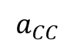
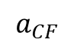
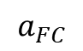
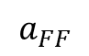
HMM
$$x$$
1,4,5,1,3,2,1,6,6,4,1,6,6,6,6,6,2,3,4,5,1,4,3,6,2,1,3,5,6,6,6,6,6,6,6,1,2,3,1,1,1,1,2,3,4,5,5,4
$$π$$
F,F,F,F,F,F,F,L,L,L,L,L,L,L,L,L,F,F,F,F,F,F,F,F,F,F,F,F,L,L,L,L,L,L,L,F,F,F,F,F,F,F,F,F,F,F,F,F,L,L
Come from->Goes to | F | L | Total
F | α | β | α+β
L | γ | δ | γ+δ
$$a_{FF}$$
$$a_{FC}$$
?
$$a_{CF}$$
$$a_{CC}$$

Slide 43
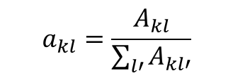
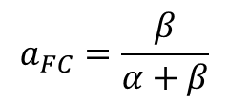
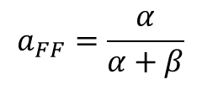
HMM
$$x$$
1,4,5,1,3,2,1,6,6,4,1,6,6,6,6,6,2,3,4,5,1,4,3,6,2,1,3,5,6,6,6,6,6,6,6,1,2,3,1,1,1,1,2,3,4,5,5,4
$$π$$
F,F,F,F,F,F,F,L,L,L,L,L,L,L,L,L,F,F,F,F,F,F,F,F,F,F,F,F,L,L,L,L,L,L,L,F,F,F,F,F,F,F,F,F,F,F,F,F,L,L
Marginal of the row
Come from->Goes to | F | C | Total
F | α | β | α+β
C | γ | δ | γ+δ
Counts in cell row k, column l
Maximum likelihood estimates
$$a_{FF}=\frac{α}{α+β}$$
$$a_{FC}=\frac{β}{α+β}$$
$$a_{kl}=\frac{A_{kl}}{\sum_{l′}{A_{kl′}}}$$
Counts in row k (Marginal)
Row k
“come from”
Column l
“go to”

Slide 44
HMM
Why the maximum likelihood can be computed like this?

Slide 45
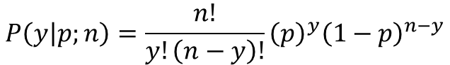
HMM
For a given “I come from” state, we have two possible movements
“I stay at the state” with probability p
“I move to the other state” with probability 1-p
We observe “I stay at the state” y observations out of n observations
Which is the statistical distribution that could model this process?
$$P\left(y | p;n\right)=\frac{n!}{y!\left(n−y\right)!}{\left(p\right)}^{y}{\left(1−p\right)}^{n−y}$$

Slide 46
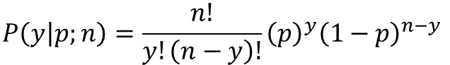
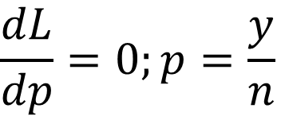
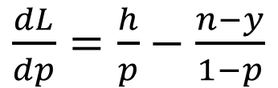
HMM
$$P\left(y | p;n\right)=\frac{n!}{y!\left(n−y\right)!}{\left(p\right)}^{y}{\left(1−p\right)}^{n−y}$$
$$\log\left(L\left(p\right)\right)=\log\left(C\right)+ylog\left(p\right)+ \left(n−y\right)log⁡(1−p)$$
$\frac{dL}{dp}=\frac{h}{p}−$ $\frac{n−y}{1−p}$
$$\frac{dL}{dp}=0;p=\frac{y}{n}$$

Slide 47





HMM
$$x$$
1,4,5,1,3,2,1,6,6,4,1,6,6,6,6,6,2,3,4,5,1,4,3,6,2,1,3,5,6,6,6,6,6,6,6,1,2,3,1,1,1,1,2,3,4,5,5,4
$$π$$
F,F,F,F,F,F,F,C,C,C,C,C,C,C,C,C,F,F,F,F,F,F,F,F,F,F,F,F,C,C,C,C,C,C,C,F,F,F,F,F,F,F,F,F,F,F,F,F
$$a_{FF}$$
State Fair
State Charged
$$a_{CC}$$
Probability of making a change from one state to another
$$a_{CF}$$
$$a_{FC}$$
Emission probabilities of fair dice
Emission probabilities of charged dice
1 | 2 | 3 | 4 | 5 | 6
? | ? | ? | ? | ? | ?
1 | 2 | 3 | 4 | 5 | 6
? | ? | ? | ? | ? | ?
Fair (F) dice
Loaded (L) dice

Slide 48
HMM
$$x$$
1,4,5,1,3,2,1,6,6,4,1,6,6,6,6,6,2,3,4,5,1,4,3,6,2,1,3,5,6,6,6,6,6,6,6,1,2,3,1,1,1,1,2,3,4,5,5,4
$$π$$
F,F,F,F,F,F,F,C,C,C,C,C,C,C,C,C,F,F,F,F,F,F,F,F,F,F,F,F,C,C,C,C,C,C,C,F,F,F,F,F,F,F,F,F,F,F,F,F
$$a_{FF}$$
State Fair
State Charged
$$a_{CC}$$
Probability of making a change from one state to another
$$a_{CF}$$
$$a_{FC}$$
Emission probabilities of fair dice
Emission probabilities of loaded dice
1 | 2 | 3 | 4 | 5 | 6
? | ? | ? | ? | ? | ?
1 | 2 | 3 | 4 | 5 | 6
? | ? | ? | ? | ? | ?
Fair (F) dice
Loaded (L) dice

Slide 49
HMM
$$x$$
1,4,5,1,3,2,1,6,6,4,1,6,6,6,6,6,2,3,4,5,1,4,3,6,2,1,3,5,6,6,6,6,6,6,6,1,2,3,1,1,1,1,2,3,4,5,5,4
$$π$$
F,F,F,F,F,F,F,C,C,C,C,C,C,C,C,C,F,F,F,F,F,F,F,F,F,F,F,F,C,C,C,C,C,C,C,F,F,F,F,F,F,F,F,F,F,F,F,F
How would you do it?

Slide 50



HMM
$$x$$
1,4,5,1,3,2,1,6,6,4,1,6,6,6,6,6,2,3,4,5,1,4,3,6,2,1,3,5,6,6,6,6,6,6,6,1,2,3,1,1,1,1,2,3,4,5,5,4
$$π$$
F,F,F,F,F,F,F,C,C,C,C,C,C,C,C,C,F,F,F,F,F,F,F,F,F,F,F,F,C,C,C,C,C,C,C,F,F,F,F,F,F,F,F,F,F,F,F,F
$$x$$ | F
1 | $$n_{1F}$$
2 | $$n_{2F}$$
3 | $$n_{3F}$$
4 | $$n_{4F}$$
5 | $$n_{5F}$$
6 | $$n_{6F}$$
$$x$$ | $$P\left(x | F\right)$$
1 | $${n_{2F}}/{N_{F}}$$
2 | $${n_{2F}}/{N_{F}}$$
3 | $${n_{3F}}/{N_{F}}$$
4 | $${n_{4F}}/{N_{F}}$$
5 | $${n_{5F}}/{N_{F}}$$
6 | $${n_{6F}}/{N_{F}}$$
$$e_{k}\left(b\right)=\frac{E_{k}\left(b\right)}{\sum_{b′}{E_{k}\left(b′\right)}}$$
Can you identify the different variables?

Slide 51
HMM
Once the parameters have been estimated in training, they must be validated in a different dataset not used for training (replication)
Confusion matrix. In classification tasks, it allows to estimate how good is the model
Viterbi | F is predicted given HMM | C is predicted given HMM
F is true in replication
C is true in replication
I would like this to be as close as possible to 100%
P(S|HMM)
Check also

Slide 52

HMM
The occasionally dishonest casino problem
Unknown paths
$$x$$
1,4,5,1,3,2,1,6,6,4,1,6,6,6,6,6,2,3,4,5,1,4,3,6,2,1,3,5,6,6,6,6,6,6,6,1,2,3,1,1,1,1,2,3,4,5,5,4
How to find HMM that maximizes P(X|HMM)?

Slide 53

HMM
The occasionally dishonest casino problem
Unknown paths
$$x$$
1,4,5,1,3,2,1,6,6,4,1,6,6,6,6,6,2,3,4,5,1,4,3,6,2,1,3,5,6,6,6,6,6,6,6,1,2,3,1,1,1,1,2,3,4,5,5,4
Likelihood of an observed sequence given a set of transition and emission probabilities from a given HMM, computed using the forward algorithm
P(x|HMM=$a_{rk};e_{k}\left(b\right)$)
How to find HMM that maximizes P(X|HMM)?

Slide 54
HMM
How to find HMM that maximizes P(X|HMM)?
Xi with maximum f(x) over all the function
Shape of the function is unknown
(we only know f(xi) when we evaluate x)
Xi with maximum f(x) over the surrounding area

Slide 55

HMM
The occasionally dishonest casino problem
Optimization of a and e using The Genetic Algorithm

Slide 56

Classical Genetic algorithm

Slide 57

Classical Genetic algorithm
What do we need?
A chromosome based representation of the solution that we are searching for:

Slide 58



Classical Genetic algorithm
What do we need?
A way to generate new solutions by recombination from previous ones (Mating & Recombination):
By setting few crossover points
Binary
…
By setting random uniform crossovers
Continuous
Not allowing repeated values within each offspring
By mixing at each gene the proportions of the parents
Clustering based labeling

Slide 59

Classical Genetic algorithm
What do we need?
A way to generate new solutions by recombination from previous ones (Mating & Recombination):
Single crossover
Real valued genotypes

Slide 60
Classical Genetic algorithm
How to introduce new solutions (mutation)?
f(px) ?
p2

Slide 61
Classical Genetic algorithm Other hyperparameters to consider
How many?
Too high = time consuming. Slow convergence
Too small = noise will tend to predominate over selection
Population of answers
Which fitness?
Which elitism?
(too small = a lot of bad solutions
Too high = risk of ending in a local solution)
Select best answers
For how long?
Next generation
Random mating
How do I allow the best to mate?
At random?
Best have the higher frequency of mating?
Tournament selection?
Recombination/Mutation
Which mutation frequency?
Too small = result will tend to be local
Too high = random walking (no need
of doing a GA!)

Slide 62




HMM
The occasionally dishonest casino problem
Optimization of a and e using The Genetic Algorithm
Chromosome structure
Which are the parameters?
$$x$$ | $$P\left(x | F\right)$$
1
2
3
4
5
6
$$x$$ | $$P\left(x | C\right)$$
1
2
3
4
5
6
“Put in a vector the parameters you want to estimate”
$$P\left(C | F\right)$$
$$P\left(F | C\right)$$

Slide 63

HMM
The occasionally dishonest casino problem
Optimization of a and e using The Genetic Algorithm
Coding of the matrices in a vector (=Chromosome in GA). Example
This is because in this case they are using characters for speech recognition problems
Optimization of HMM by a GA

Slide 64
HMM
The occasionally dishonest casino problem
Optimization of a and e using The Genetic Algorithm
Chromosome structure
Which are the parameters?
$$x$$ | $$P\left(x | F\right)$$
1
2
3
4
5
6
$$x$$ | $$P\left(x | C\right)$$
1
2
3
4
5
6
“Put in a vector the parameters you want to estimate”
“taking into account possible conditions”
All these variables must add to one
$$P\left(C | F\right)$$
$$P\left(F | C\right)$$

Slide 65
HMM
The occasionally dishonest casino problem
Optimization of a and e using The Genetic Algorithm
Chromosome structure
Which are the parameters?
$$x$$ | $$P\left(x | F\right)$$
1
2
3
4
5
6
$$x$$ | $$P\left(x | C\right)$$
1
2
3
4
5
6
“Put in a vector the parameters you want to estimate”
“taking into account possible conditions”
All these variables must add to one
$$P\left(C | F\right)$$
$$P\left(F | C\right)$$

Slide 66

HMM
The occasionally dishonest casino problem
Optimization of a and e using The Genetic Algorithm
Chromosome structure
Which are the parameters?
States P(Sj|Si) | $$S_{1}$$ | $$S_{2}$$ | $$S_{n}$$
$$S_{1}$$
$$S_{2}$$
$$S_{n}$$
“Put in a vector the parameters you want to estimate”
“taking into account possible conditions”
All these variables must add to one

Slide 67
HMM
The occasionally dishonest casino problem
Optimization of a and e using The Genetic Algorithm
Chromosome structure
Which are the parameters?
$$x$$ | $$P\left(x | F\right)$$
1
2
3
4
5
6
$$x$$ | $$P\left(x | C\right)$$
1
2
3
4
5
6
“Put in a vector the parameters you want to estimate”
“taking into account possible conditions”
How many independent variables do we have here?
$$P\left(C | F\right)$$
$$P\left(F | C\right)$$

Slide 68
HMM
The occasionally dishonest casino problem
Optimization of a and e using The Genetic Algorithm
Chromosome structure
Which are the parameters?
$$x$$ | $$P\left(x | F\right)$$
1
2
3
4
5
6
$$x$$ | $$P\left(x | C\right)$$
1
2
3
4
5
6
“Put in a vector the parameters you want to estimate”
“taking into account possible conditions”
How many independent variables do we have here?
5 (because all the variables must add to 1)
$$P\left(C | F\right)$$
$$P\left(F | C\right)$$
In statistical jargon we would say n-1 degrees of freedom

Slide 69
HMM
The occasionally dishonest casino problem
Optimization of a and e using The Genetic Algorithm
Chromosome structure
“Put in a vector the parameters you want to estimate”
“taking into account possible conditions”
Some subsets of parameters must add to 1 (we can exclude one)
All parameters cannot be greater than 1
Conditions of this particular problem
Find a way how to transform the variables so the conditions are fulfilled

Slide 70





HMM
Discrete probability function
Logit transformation for a binary variable
$$P\left(i\right)=p_{i}$$
$$θ_{i}=log\left(\frac{p_{i}}{1−p_{i}}\right)$$
$$\sum_{i}^{K}{p_{i}=1}$$
Which is the range?
Which is the range?
$$p\sim U(0,1)$$
Looks like a Normal distribution, but it is not

Slide 71
HMM
Discrete probability function
Logit transformation for a binary variable
$$P\left(i\right)=p_{i}$$
$$θ_{i}=log\left(\frac{p_{i}}{1−p_{i}}\right)$$
$$\sum_{i}^{K}{p_{i}=1}$$
How to estimate pi?

Slide 72


HMM
Discrete probability function
“Logit transformation of multinomial distribution”
$$P\left(i\right)=p_{i}$$
$$\sum_{i}^{K}{p_{i}=1}$$
$$p_{i}=\frac{e^{θ_{i}^{}}}{1+\sum_{j}^{K−1}{e^{θ_{j}^{}}}}$$
$$p_{K}=1−\sum_{j}^{K−1}{p_{j}}$$

Slide 73

HMM
The occasionally dishonest casino problem
Optimization of a and e using The Genetic Algorithm
$$e_{1}$$ | $$e_{1}$$ | $$e_{1}$$ | $$e_{1}$$ | $$e_{1}$$ | …
We need to keep track to which table each parameter refers to (BUT IT IS NOT CODED IN THE chromosome)
Chromosome structure
$$θ_{1}$$ | $$θ_{2}$$ | $$θ_{3}$$ | $$θ_{4}$$ | $$θ_{5}$$
Which are the parameters?
$$x$$ | $$P\left(x | F\right)$$
1
2
3
4
5
6
$$x$$ | $$P\left(x | C\right)$$
1
2
3
4
5
6
$$p_{i}=\frac{e^{θ_{i}^{}}}{1+\sum_{j}^{K−1}{e^{θ_{j}^{}}}}$$
$$P\left(C | F\right)$$
Decode the information of the chromosome
$$P\left(F | C\right)$$

Slide 74
HMM
The occasionally dishonest casino problem
Optimization of a and e using The Genetic Algorithm
Breakpoints
$$θ_{1,1}$$ | $$θ_{2,1}$$ | $$θ_{3,1}$$ | $$θ_{4,1}$$ | $$θ_{5,1}$$ | $$θ_{1,1}$$ | $$θ_{2,1}$$ | $$θ_{3,1}$$ | $$…$$
Parents
$$θ_{1,2}$$ | $$θ_{2,2}$$ | $$θ_{3,2}$$ | $$θ_{4,2}$$ | $$θ_{5,2}$$ | $$θ_{1,2}$$ | $$θ_{2,2}$$ | $$θ_{3,2}$$ | $$…$$
$$θ_{1,1}$$ | $$θ_{2,1}$$ | $$θ_{3,1}$$ | $$θ_{4,2}$$ | $$θ_{5,2}$$ | $$θ_{1,2}$$ | $$θ_{2,1}$$ | $$θ_{3,1}$$ | $$…$$
Offspring
$$θ_{1,2}$$ | $$θ_{2,2}$$ | $$θ_{3,2}$$ | $$θ_{4,1}$$ | $$θ_{5,1}$$ | $$θ_{1,1}$$ | $$θ_{2,2}$$ | $$θ_{3,2}$$ | $$…$$

Slide 75
HMM
The occasionally dishonest casino problem
Optimization of a and e using The Genetic Algorithm
Breakpoints
$$θ_{1,1}$$ | $$θ_{2,1}$$ | $$θ_{3,1}$$ | $$θ_{4,1}$$ | $$θ_{5,1}$$ | $$θ_{1,1}$$ | $$θ_{2,1}$$ | $$θ_{3,1}$$ | $$…$$
Parents
$$θ_{1,2}$$ | $$θ_{2,2}$$ | $$θ_{3,2}$$ | $$θ_{4,2}$$ | $$θ_{5,2}$$ | $$θ_{1,2}$$ | $$θ_{2,2}$$ | $$θ_{3,2}$$ | $$…$$
$$θ_{1,1}$$ | $$θ_{2,1}$$ | $$θ_{3,1}$$ | $$θ_{4,2}$$ | $$θ_{5,2}$$ | $$θ_{1,2}$$ | $$θ_{2,1}$$ | $$θ_{3,1}$$ | $$…$$
Offspring
$$θ_{1,2}$$ | $$θ_{2,2}$$ | $$θ_{3,2}$$ | $$θ_{4,1}$$ | $$θ_{5,1}$$ | $$θ_{1,1}$$ | $$θ_{2,2}$$ | $$θ_{3,2}$$ | $$…$$

Slide 76



HMM
The occasionally dishonest casino problem
Optimization of a and e using The Genetic Algorithm
$$θ_{1,2}$$ | $$θ_{2,2}$$ | $$θ_{3,2}$$ | $$θ_{4,1}$$ | $$θ_{5,1}$$ | $$θ_{1,1}$$ | $$θ_{2,2}$$ | $$θ_{3,2}$$ | $$…$$
Pick one of the variables at random
Mutation
Propose a new $θ_{4,1}^{t+1}$ using $N\left(θ_{4,1}^{t},sd\right)$
$$θ_{4,1}$$

Slide 77
Classical Genetic algorithm Other hyperparameters to consider
Population of answers
Which fitness?
Select best answers
Next generation
Random mating
Recombination/Mutation

Slide 78

HMM
The occasionally dishonest casino problem
Optimization of a and e using The Genetic Algorithm
Optimization of HMM by a GA

Slide 79
HMM
The occasionally dishonest casino problem
Baum–Welch algorithm
$$x$$
1,4,5,1,3,2,1,6,6,4,1,6,6,6,6,6,2,3,4,5,1,4,3,6,2,1,3,5,6,6,6,6,6,6,6,1,2,3,1,1,1,1,2,3,4,5,5,4
Likelihood of an observed sequence given a set of transition and emission probabilities from a given HMM, computed using the forward algorithm
P(x|HMM=$a_{rk};e_{k}\left(b\right)$)

Slide 80




HMM
Imagine I could establish the probability of observing F,F given the sequence and the observed symbols and a proposed $a_{kl}$
$$x$$
1,4,5,1,3,2,1,6,6,4,1,6,6,6,6,6,2,3,4,5,1,4,3,6,2,1,3,5,6,6,6,6,6,6,6,1,2,3,1,1,1,1,2,3,4,5,5,4
$$π$$
F,F,F,F,F,F,F,C,C,C,C,C,C,C,C,C,F,F,F,F,F,F,F,F,F,F,F,F,C,C,C,C,C,C,C,F,F,F,F,F,F,F,F,F,F,F,F,F
Which is the probability of observing this sequence given a transition $a_{kl}$ probability and all the observed sequence?
$$P\left(π_{i}=k;π_{i+1}=l | x;HMM\right)=\frac{P\left(π_{i}=k | x_{1}..x_{i};HMM\right)P\left(x_{i} | π_{i}=k;HMM\right)P\left(π_{i+1}=l | π_{i}=k;HMM\right)P\left(x_{i+1} | π_{i+1}=l;HMM\right) P(π_{i+1}=l|x_{i+1}…x_{L};HMM)}{P\left(x\right)}$$
Probability of observing state k at position I, state l at osition i+1 given the observed sequence of symbols and a proposal of parameters
Emission probability of symbol x at position i using state k
Transition probability of state k to l
Emission probability of symbol x at position i+1 using state l
$$P\left(π_{i}=k;π_{i+1}=l | x;HMM\right)=\frac{P\left(π_{i}=k | x_{1}..x_{i};HMM\right)e_{k}\left(b=x_{i}\right)a_{kl}e_{l}\left(b=x_{i+1}\right)P(π_{i+1}=l|x_{i+1}…x_{L};HMM)}{P\left(x\right)}$$
Knowing that, I would be able to get a new estimate of the expected number of times that I expect to see such combination of k and l and, given that, propose a new $a_{kl}$ to maximize the likelihood of the data given the parameters.

Slide 81

HMM
i
$$x$$
1,4,5,1,3,2,1,6,6,4,1,6,6,6,6,6,2,3,4,5,1,4,3,6,2,1,3,5,6,6,6,6,6,6,6,1,2,3,1,1,1,1,2,3,4,5,5,4
$$P\left(π_{i}=k | x\right)=\frac{P\left(π_{i}=k,x\right)}{P\left(x\right)}$$
“I want to know the probability of state k at position i given that I have observed the whole sequence x”

Slide 82

HMM
i
$$x$$
1,4,5,1,3,2,1,6,6,4,1,6,6,6,6,6,2,3,4,5,1,4,3,6,2,1,3,5,6,6,6,6,6,6,6,1,2,3,1,1,1,1,2,3,4,5,5,4
$$P\left(π_{i}=k,x_{1}…x_{i}\right)$$
$$P\left(x_{i+1}…x_{L} | π_{i}=k,x_{1}…x_{i}\right)$$
$P\left(π_{i}=k,x\right)$=$P\left(π_{i}=k,x_{1}…x_{i}\right)P\left(x_{i+1}…x_{L} | π_{i}=k,x_{1}…x_{i}\right)$

Slide 83

HMM
i
$$x$$
1,4,5,1,3,2,1,6,6,4,1,6,6,6,6,6,2,3,4,5,1,4,3,6,2,1,3,5,6,6,6,6,6,6,6,1,2,3,1,1,1,1,2,3,4,5,5,4
$$P\left(π_{i}=k,x_{1}…x_{i}\right)$$
$$P\left(x_{i+1}…x_{L} | π_{i}=k\right)$$
Because it only depends on the last element!
$P\left(π_{i}=k,x\right)$=$P\left(π_{i}=k,x_{1}…x_{i}\right)P\left(x_{i+1}…x_{L} | π_{i}=k\right)$

Slide 84

HMM
i
$$x$$
1,4,5,1,3,2,1,6,6,4,1,6,6,6,6,6,2,3,4,5,1,4,3,6,2,1,3,5,6,6,6,6,6,6,6,1,2,3,1,1,1,1,2,3,4,5,5,4
$$P\left(π_{i}=k,x_{1}…x_{i}\right)$$
$$P\left(x_{i+1}…x_{L} | π_{i}=k\right)=b_{k}\left(i\right)$$
$$P\left(π_{i}=k | x\right)=\frac{P\left(π_{i}=k\right)P\left(x | π_{i}=k\right)}{P\left(x\right)}$$

Slide 85

HMM
The occasionally dishonest casino problem
$$x$$
1,4,5,1,3,2,1,6,6,4,1,6,6,6,6,6,2,3,4,5,1,4,3,6,2,1,3,5,6,6,6,6,6,6,6,1,2,3,1,1,1,1,2,3,4,5,5,4
Imagine we have observed this part of the sequence
Imagine we know the parameters of the HMM (A, B)
$$P\left(X_{1},X_{2}…X_{i},π_{i}=l | HMM\right)$$
“Which is the probability that I observe the sequence of symbols and at position i the state is l given the parameters of my HMM?”

Slide 86

HMM
The occasionally dishonest casino problem
$$x$$
1,4,5,1,3,2,1,6,6,4,1,6,6,6,6,6,2,3,4,5,1,4,3,6,2,1,3,5,6,6,6,6,6,6,6,1,2,3,1,1,1,1,2,3,4,5,5,4
Imagine we have observed this part of the sequence
Imagine we know the parameters of the HMM (A, B)
$$P\left(X_{1},X_{2}…X_{i},π_{i}=l | HMM\right)$$
Transition probability matrix
“Which is the probability that I observe the sequence of symbols and at position i the state is l given the parameters of my HMM?”
Emission probability matrix

Slide 87

Forward algorithm: how to estimate the probability of a sequence ending in state k given a HMM
HMM
$$P\left(X_{1},X_{2}…X_{i},π_{i}=l | HMM\right)$$
“Which is the probability that I observe the sequence of symbols and at position i the state is k given the parameters of my HMM?”

Slide 88


Forward algorithm: how to estimate the probability of a sequence ending in state k given a HMM
HMM
 | 1 | 3 | 4 | …
F | 0.5*1/6 | 0.5*1/6*0.99*1/6+ 0.5*1/10*0.1*1/6
C | 0.5*1/10 | 0.5*1/10*0.9*1/10 + 0.5*1/6*0.01*1/6
P1
P1+P2 =P(S|HMM)
P2
$$P\left(X_{1},X_{2},π_{i}=F | HMM\right)$$
$$P\left(X_{1},X_{2},π_{i}=C | HMM\right)$$

Slide 89

Forward algorithm: how to estimate the probability of a sequence ending in state k given a HMM
HMM
$$P\left(X_{1},X_{2}…X_{i+1},π_{i+1}=l | HMM\right)=f_{l}\left(X_{i+1}\right)=e_{l}\left(X_{i+1}\right)\sum_{r}^{K}{f_{r}\left(X_{i}\right)a_{rl}}$$
Transition probability to move from state r to l
Emission probability of X at time i+1 given that the state is l
Probability of the sequence up to i , ending at i in state r
“Which is the probability that I observe the sequence of symbols and at position i the state is k given the parameters of my HMM?”

Slide 90




Forward algorithm: how to estimate the probability of a sequence ending in state k given a HMM
HMM
$$e_{l}\left(X_{i+1}\right)$$
 | 1 | 3 | 4 | …
F | 0.5*1/6 | 0.5*1/6*0.99*1/6+ 0.5*1/10*0.1*1/6
C | 0.5*1/10 | 0.5*1/10*0.9*1/10 + 0.5*1/6*0.01*1/6
P1
P1+P2 =P(S|HMM)
P2
$$a_{rl}$$
$$f_{l}\left(X_{i+1}\right)=e_{l}\left(X_{i+1}\right)\sum_{r}^{K}{f_{r}\left(X_{i}\right)a_{rl}}$$
$$f_{r}\left(X_{i}\right)$$

Slide 91

Another way of visualizing the forward algorithm
http://www.adeveloperdiary.com/data-science/machine-learning/forward-and-backward-algorithm-in-hidden-markov-model/

Slide 92

Forward algorithm: how to estimate the probability of a sequence ending in state k given a HMM. Pseudocode (From the book of Durbin)
HMM

Slide 93




In fact, there is an initial state and a final state
HMM
Initial state (“I go to the casino”)
Final state (“Ehem”)

Slide 94
Forward algorithm: There are two other states!
HMM
“After we start the sequence, the probability of going to initial state is 0”
“Before we start the sequence, we are at the initial state”
 | NA | 1 | 3 | 4 | … | L+1
Initial State | 1 | 0 | 0 | 0 | 0 | 0
F | 0 |  |  |  |  | 0
C | 0 |  |  |  |  | 0
Final State | 0 | 0 | 0 | 0 | 0 | P(S|HMM)

Slide 95
Forward algorithm: There are two other states!
HMM
“After we finish the sequence, the probability akl of going to the final state is 1”
 | NA | 1 | 3 | 4 | … | L+1
Initial State | 1 | 0 | 0 | 0 | 0 | 0
F | 0 |  |  |  |  | 0
C | 0 |  |  |  |  | 0
Final State | 0 | 0 | 0 | 0 | 0 | P(S|HMM)

Slide 96
HMM
i
$$x$$
1,4,5,1,3,2,1,6,6,4,1,6,6,6,6,6,2,3,4,5,1,4,3,6,2,1,3,5,6,6,6,6,6,6,6,1,2,3,1,1,1,1,2,3,4,5,5,4
$$P\left(x_{i+1}…x_{L} | π_{i}=k\right)=b_{k}\left(i\right)$$

Slide 97
HMM
i
$$x$$
1,4,5,1,3,2,1,6,6,4,1,6,6,6,6,6,2,3,4,5,1,4,3,6,2,1,3,5,6,6,6,6,6,6,6,1,2,3,1,1,1,1,2,3,4,5,5,4
$$P\left(x_{i+1}…x_{L} | π_{i}=k\right)=b_{k}\left(i\right)$$
 | … | 5 | 5 | 4
F
C
Backward algorithm: how to estimate the probability of a sequence given an initial k state

Slide 98
HMM
Backward algorithm
i
$$x$$
1,4,5,1,3,2,1,6,6,4,1,6,6,6,6,6,2,3,4,5,1,4,3,6,2,1,3,5,6,6,6,6,6,6,6,1,2,3,1,1,1,1,2,3,4,5,5,4
$$P\left(x_{i+1}…x_{L} | π_{i}=k\right)=b_{k}\left(i\right)$$
 | … | 5 | 5 | 4
F |  |  |  | 1
C |  |  |  | 1
Starting at the last element, the entries in this column denote the probability moving to the end state from each state after generating the entire sequence.

Slide 99


HMM
Backward algorithm
i
$$x$$
1,4,5,1,3,2,1,6,6,4,1,6,6,6,6,6,2,3,4,5,1,4,3,6,2,1,3,5,6,6,6,6,6,6,6,1,2,3,1,1,1,1,2,3,4,5,5,4
$$P\left(x_{i+1}…x_{L} | π_{i}=k\right)=b_{k}\left(i\right)$$
 | … | 5 | 5 | 4
F |  |  |  | 1
C |  |  |  | 1
$$a_{kr}e_{r}\left(X_{i}\right)b_{k}\left(i\right)$$
$$0.95∗\frac{1}{6}∗1$$

Slide 100



HMM
Backward algorithm
i
$$x$$
1,4,5,1,3,2,1,6,6,4,1,6,6,6,6,6,2,3,4,5,1,4,3,6,2,1,3,5,6,6,6,6,6,6,6,1,2,3,1,1,1,1,2,3,4,5,5,4
$$P\left(x_{i+1}…x_{L} | π_{i}=k\right)=b_{k}\left(i\right)$$
 | … | 5 | 5 | 4
F |  |  | $$0.95∗\frac{1}{6}∗1$$ | 1
C |  |  |  | 1
$$a_{kr}e_{r}\left(X_{i}\right)b_{k}\left(i\right)$$
$$0.05∗\frac{1}{6}∗1$$

Slide 101

HMM
Backward algorithm
i
$$x$$
1,4,5,1,3,2,1,6,6,4,1,6,6,6,6,6,2,3,4,5,1,4,3,6,2,1,3,5,6,6,6,6,6,6,6,1,2,3,1,1,1,1,2,3,4,5,5,4
$$P\left(x_{i+1}…x_{L} | π_{i}=k\right)=b_{k}\left(i\right)$$
 | … | 5 | 5 | 4
F |  |  | $0.95∗\frac{1}{6}∗1$+$0.05∗\frac{1}{6}∗1$ | 1
C |  |  |  | 1
$$a_{kr}e_{r}\left(X_{i}\right)b_{k}\left(i\right)$$
$$0.05∗\frac{1}{6}∗1$$

Slide 102

HMM
Backward algorithm
i
$$x$$
1,4,5,1,3,2,1,6,6,4,1,6,6,6,6,6,2,3,4,5,1,4,3,6,2,1,3,5,6,6,6,6,6,6,6,1,2,3,1,1,1,1,2,3,4,5,5,4
$$P\left(x_{i+1}…x_{L} | π_{i}=k\right)=b_{k}\left(i\right)$$
 | … | 5 | 5 | 4
F |  |  | $$0.95∗\frac{1}{6}∗1\text{+}0.05∗\frac{1}{6}∗1$$ | 1
C |  |  | $0.9∗\frac{1}{10}∗1$+$0.1∗\frac{1}{10}∗1$ | 1

Slide 103

Another way of visualizing the backward algorithm
http://www.adeveloperdiary.com/data-science/machine-learning/forward-and-backward-algorithm-in-hidden-markov-model/

Slide 104
HMM
Backward algorithm
Remember: Even if we have not explicitly stated, beginning and end are also states
What is strange in this HMM compared to the ones we have been using?

Slide 105
HMM
Backward algorithm
If our subsequence was TAGA, which is the probability that we have ended at that each stage?

Slide 106

HMM
Backward algorithm

Slide 107

HMM
The occasionally dishonest casino problem
Baum–Welch algorithm
Probability of ending at position i in state k
Probability that I change from k to l
Probability of emission of symbol x at position i+1 using state l
$$P\left(π_{i}=k,π_{i+1}=l | X,HMM\right)=\frac{f_{k}\left(i\right)a_{kl}e_{l}\left(x_{i+1}\right)b_{l}\left(i+1\right)}{P\left(X\right)}$$
Probability of the sequence from i+1 to L if I start at i+1 at state l
Probability of a transition from state k at position i to state l in position i+1

Slide 108


HMM
The occasionally dishonest casino problem
Baum–Welch algorithm
We can do this for each position. Adding over all the positions, we have an estimate of “how often would occur a transition from state k to l if the parameter $a_{kl}$ that we are using was the one that generated the data”
$$A_{kl}=\sum_{i}^{L}{P\left(π_{i}=k,π_{i+1}=l | X,HMM\right)}$$
$$a_{kl}^{(t+1)}=\frac{A_{kl}^{t}}{\sum_{l′}^{K}{A_{kl′}^{t}}}$$
“Given that I come from state k, which is the probability of moving to any other state”
When the state was not hidden, this was the maximum likelihood estimate of the transition akl!
Posterior probability of akl(t+1) given akl(t) and the observed data

Slide 109



HMM
The occasionally dishonest casino problem
Baum–Welch algorithm
How can we estimate the emission probabilities?
$$x$$
1,4,5,1,3,2,1,6,6,4,1,6,6,6,6,6,2,3,4,5,1,4,3,6,2,1,3,5,6,6,6,6,6,6,6,1,2,3,1,1,1,1,2,3,4,5,5,4
Pick one of the symbols (for example, b = 6)
The index i of this position is 8
$$E_{k}\left(b\right)=\frac{1}{P\left(x\right)}\sum_{\left\{i | x_{i}=b\right\}}{f_{k}\left(i\right)b_{k}\left(i\right)}$$
Probability that we are at state k in position i
New emission probabilities
$$e_{k}^{t+1}\left(b\right)=\frac{E_{k}\left(b\right)}{\sum_{b′}{E_{k}\left(b′\right)}}$$
For all the positions where we observe 6

Slide 110
HMM
Baum-Welch algorithm
1) Propose a set of transition (a..) and emission (b.(.)) matrices
2) Until change of likelihood P(X|HMM) is not smaller than threshold, do
3) Using the forward and backward algorithm, estimate the new A.. and B.. variables
4) Estimate the new a.. and b.(.) matrices
5) Go to 2)

Slide 111
The Baum-Welch is a special case of the EM algorithm
Two steps
Expectation: missing data are estimated given the observed data and current estimate of the model parameters.
Maximization: the likelihood function is maximized under the assumption that the missing data are known.

Slide 112
How does a phenotype change over a phylogeny?
Identifying Hidden Rate Changes in the Evolution of a Binary Morphological Character:
The Evolution of Plant Habit in Campanulid Angiosperms
JEREMY M. BEAULIEU1,∗, BRIAN C. O’MEARA2, AND MICHAEL J. DONOGHUE1
Model adequacy is a different concern than model fit: the latter determines which of a set of models is least bad (or “best”) for the data, whereas the former determines whether a single model adequately describes the data. For example, a model that says humans, chimps, and mice all diverged simultaneously 70 million years ago is a better fit to the data than one that puts that divergence 700 million years ago, but neither model adequately describes the data. Adequacy is often evaluated by simulating under the focal model to see if it generates data indistinguishable from the empirical data using one or more measures.

